Slide 1
Data
“Three Components of
Machine Learning”
Alex Jung
Model
(Hypothesis Space)
Loss Function

Slide 2
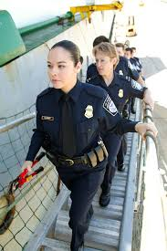

Officer Election for IEEE SP/CAS Chapter
we will organize soon chapter officer elections
officer positions:
chapter chair
chapter co-chair
chapter secretary
chapter treasurer
email me if you are interested!
James Tourtellotte, Public domain,
via Wikimedia Commons

Slide 3
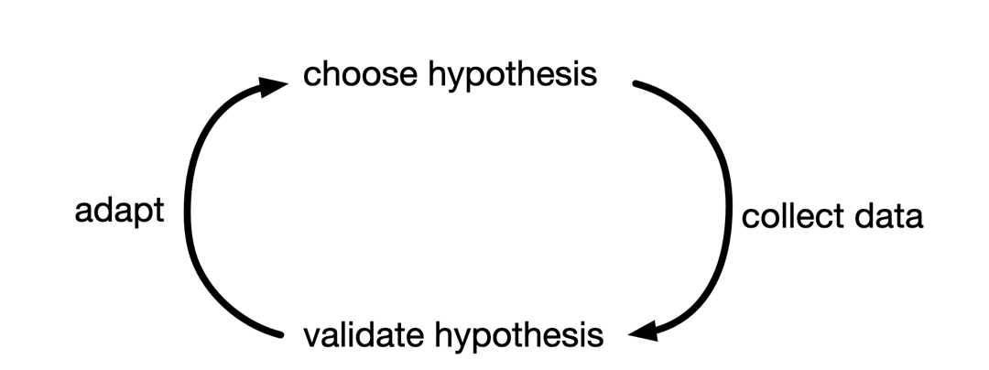
Machine Learning is computationally efficient implementation of scientific principle

Slide 4
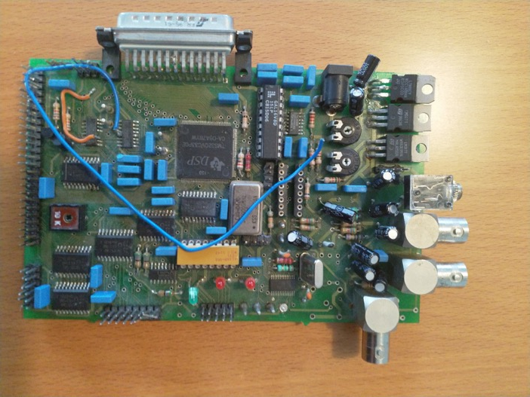
My High-School Graduation Project

Slide 5
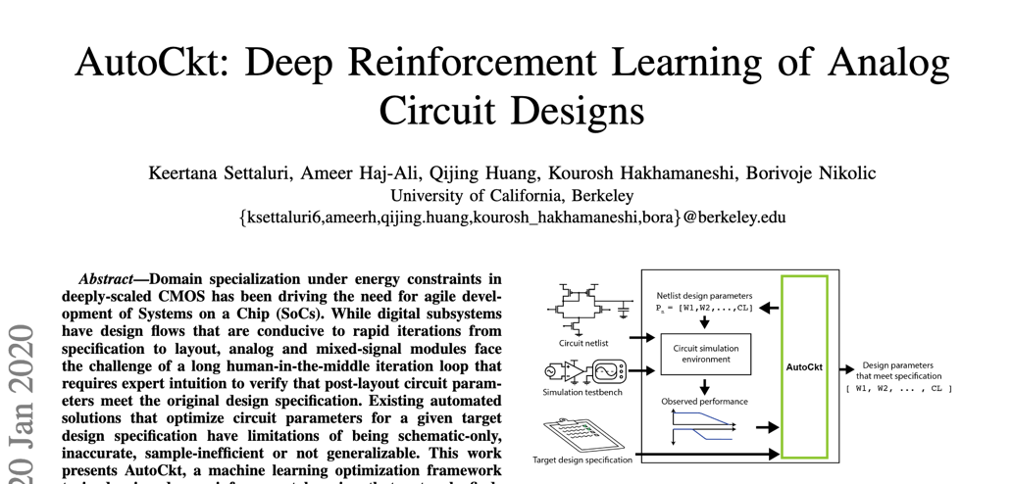
Circuit Design

Slide 6

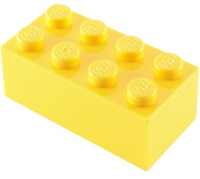
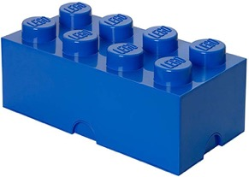
Three Main Components
data (observations)
model (hypothesis space)
loss function (performance measure)

Slide 7
Data

Slide 8
Dataset = (Large) Set of “Data Points”
data points are different objects but of similar “type”

Slide 9
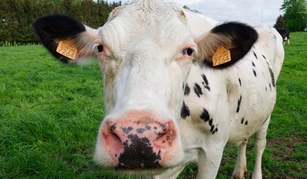
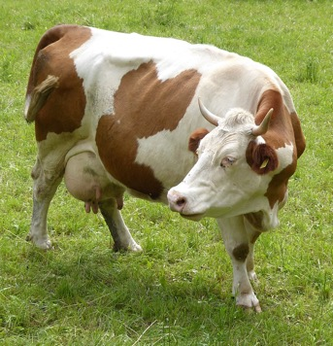
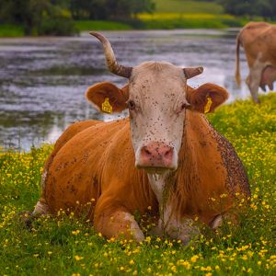
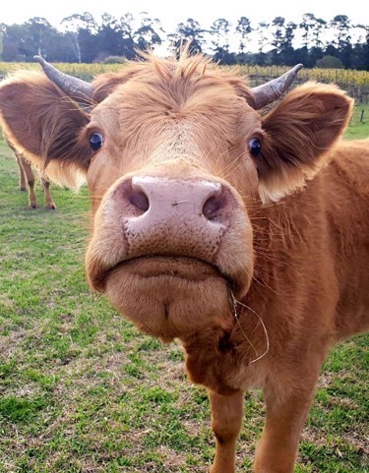
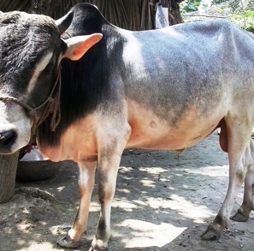
Dataset – “Cows”
Syrio / CC BY-SA (https://creativecommons.org/licenses/by-sa/4.0)

Slide 10
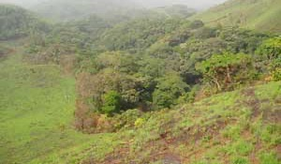
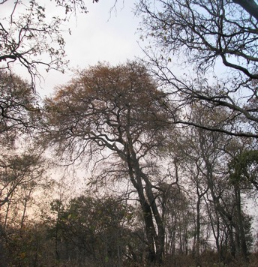
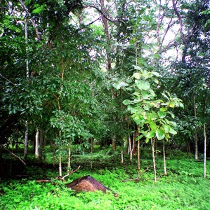
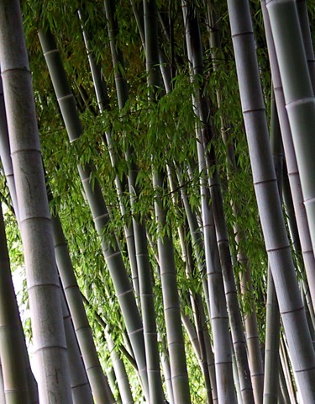
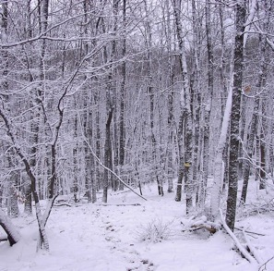
Dataset – “Forests”
CC BY-SA (https://creativecommons.org/licenses/by-sa/2.5)

Slide 11
Dataset = “Days During Pandemic”
13/Mar/2020
1/Mar/2020
2/Mar/2020
22/Apr/2020
1/Apr/2020

Slide 12
Data Point provides Atomic Unit of Information
highly abstract concept
data points can represent persons
data points can represent random variables
data points can represent machine learning problems
Notes:
since there are more than one data points, observing a particular data point provides information.

Slide 13
Features and Labels
data points often have many different properties
“features”: properties that can be measured/computed easily
“labels”: properties that are “difficult” to compute
labels are higher-level facts or quantities of interest
labels can often be determined only in hindsight
determining labels might require human (domain) experts

Slide 14

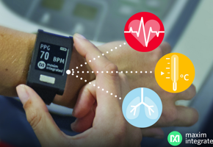
Corona ?
data point = “some human”
features = body temp., heart rate,…
label = 1 if Covid-19 infection,
0 otherwise

Slide 15
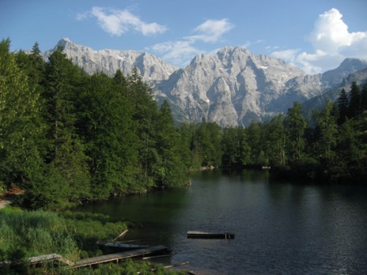
Data Point = “Some Photo”
features could include:
red, green, blue intensities of pixels
timestamp of photo
location of photo shot
identity of photographer
label:
hiking duration for the photographer
to reach mountain peak

Slide 16
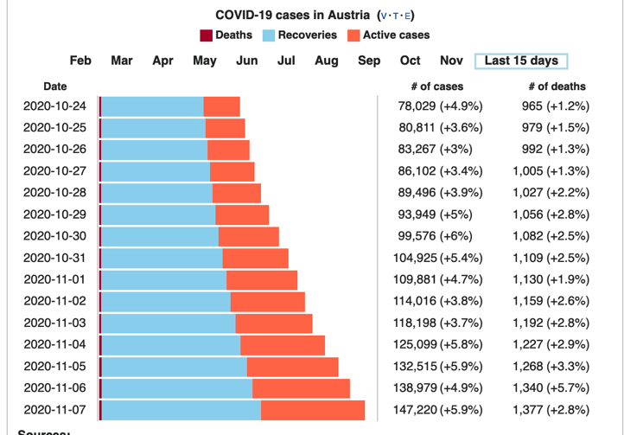
Data Point = “Some Country During Pandemic”
label: active cases
next week

Slide 17
Data Point = “Some Person”
features:
name
healthcare records
credit card transactions
social media posts
genetic fingerprint
fingerprint
travel history
label:
how likely will person need intensive care next week?

Slide 18
Data Point = “Some Dataset”
features:
number of data points
what type of features are used for data points
what label is used for data points
label:
can label value be predicted well from features?

Slide 19
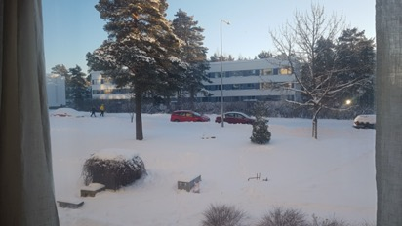
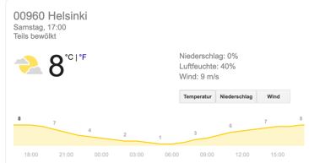
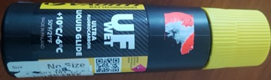
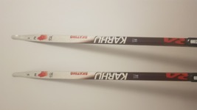
Data Point = “Some Ski-Day Ahead”
features:
snapshot in the morning
morning temperature
weather forecast
label:
maximum daytime temperature (important for ski waxing)

Slide 20
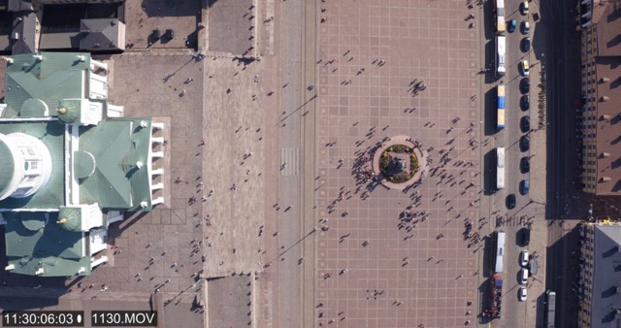
Data Point = “Place in Helsinki”
features:
coordinates of place
city building maps
current traffic statistics
CET time
drone video
label:
are people keeping average distance of >= 1 m ?

Slide 21
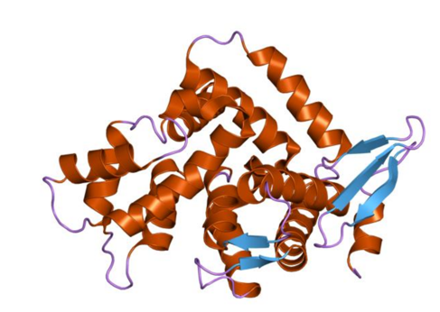
Data Point = “Some Protein”
features:
protein structure
physical measurements
scientific papers about this protein
label:
should this protein be considered for a Covid-19 vaccine?

Slide 22

Data Point = “Some Plant”
features:
plant species
RGB image
multi-spectral image
ambient temperature
label:
does the plant need more water?

Slide 23
Features and Labels Are Design Choices!
design freedom for defining/choosing features and labels
labels could be defined by humans who provide labeled examples
labels could be subset of features
Notes:
The design choice for labels is typically easier since often there is a clear quantity of interest like tmrw temperature or the future value of some share at a stock market. The design choice for what features to use is often more challenging. There is an entire subfiled of ML devoted to methods that allow to determine the best features in some sense.
“The design choices could have been discussed a bit more. Even if there are no good rules of thumb,
it would be good to learn how to get started.“

Slide 24

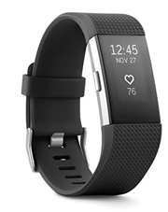
Influenza or Covid-19?
data point = “some person”
features = measurements by wearables
label could be “Covid-19 Infection?”
another label could be “Influenza?”
different choice for label results in different ML problems
related since both are contagious respiratory illnesses

Slide 25
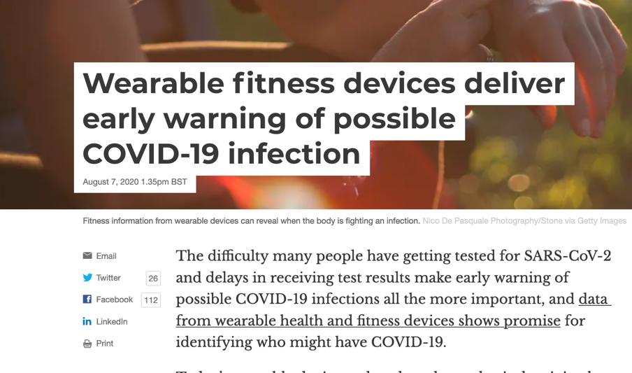
https://theconversation.com/wearable-fitness-devices-deliver-early-warning-of-possible-covid-19-infection-143388

Slide 26



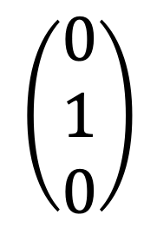
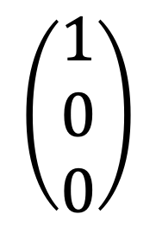
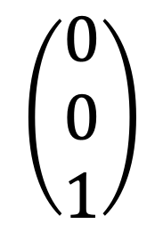
Label Encodings
consider detection of animals from a webcam
label values “wolf” vs. “bear”, vs. “lion”
we can represent label values as y=0, y=1 or y=2
another representation is “one-hot-encoding”
$$\left(\begin{aligned}1 \\ 0 \\ 0\end{aligned}\right)$$
$$\left(\begin{aligned}0 \\ 1 \\ 0\end{aligned}\right)$$
$$\left(\begin{aligned}0 \\ 0 \\ 1\end{aligned}\right)$$

Slide 27
Supervised vs. Unsupervised
methods using labels which can only be defined with the help of humans are “supervised methods”
methods using labels that can be determined automatically are “unsupervised methods”
distinction between supervised and unsupervised methods is blurry

Slide 28
Scatterplot – First Look at Data
data point
label value y
feature value x

Slide 29
Hypothesis Space

Slide 30

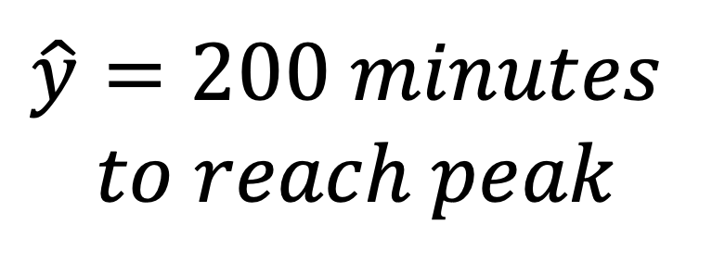
Predictor Map/Function
h(x)
$$\hat{y}=200 minutes$$
$$to reach peak$$
features x
of some data point

Slide 31
Predictor Map
some predictor
map h(x)
label value y
data point
another predictor
map h’(x)
yet another map h’’(x)
feature value x

Slide 32
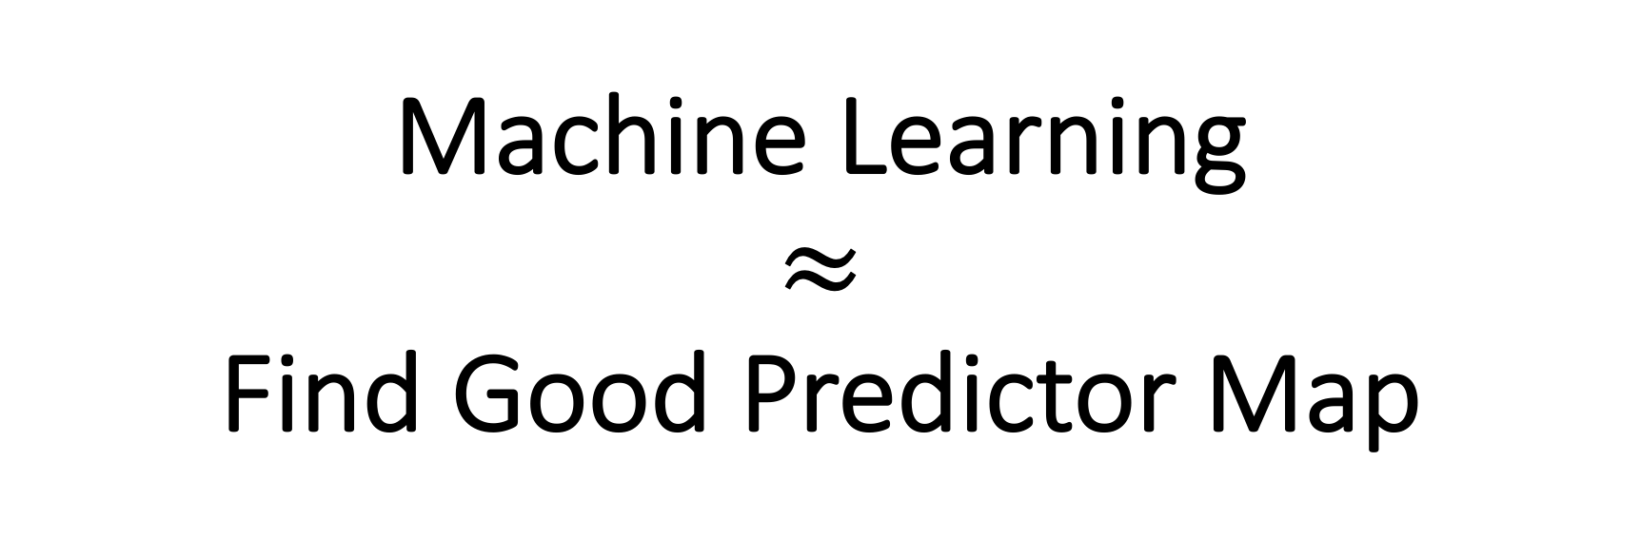
Machine Learning $≈$ Find Good Predictor Map

Slide 33
consider data points with
single numeric feature x and label y
how many predictor maps h(x) are there ?

Slide 34
have only finite computation time, memory, bandwidth ! a hypothesis space is a computationally tractable subset of predictor maps

Slide 35
hypothesis space
h(x)
h(x)
h(x)
x
x
x
machine and deep learning Python libraries provide “fit()”
function to search over (huge) hypothesis spaces

Slide 36
Machine Learning
ML aims at finding/learning a good predictor h(x)
predictor reads in features x and outputs predicted label
predictor maps reading in millions of features
must choose between many different predictor maps
deep learning uses special representation for maps

Slide 37
Artificial Neural Networks
represent predictor map h(x) using network of neurons
single neuron
feature x1
weight w1
w2
h(x) = g(z)
z = w1*x1+w2*x2+w3*x3
x2
g(.)
w3
non-linear activation function g(z)
x3

Slide 38
Activation Function
few popular choices have emerged
”ReLu”
g(z)
“Sigmoid”
z

Slide 39
(Deep) Neural Network=(Very) Non-Linear Function
w1
feature
x
w2
prediction
h(x)
adjustable weights
w1, w2, …
layer 1
layer 2

Slide 40
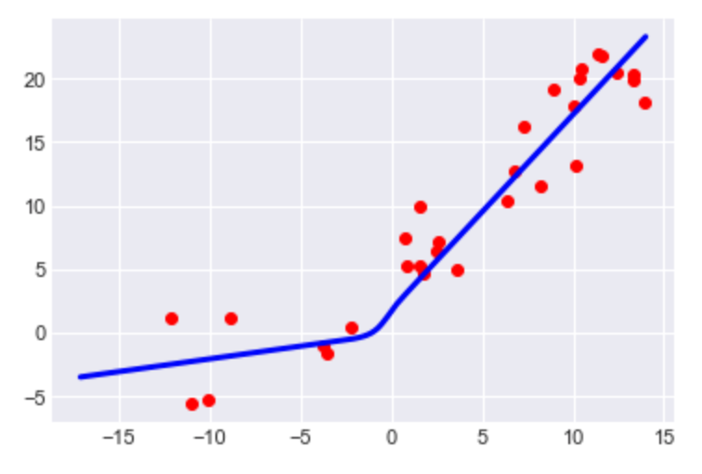
What is Deep Learning ?
label y
feature x
deep learning methods fit non-linear maps to large data sets

Slide 41
Hypothesis Space of ANN
x1
w1=1
x1
w1=1
x2
w2=0
g(.)
x2
w2=0
g(.)
x3
w3=-1
x3
w3=-3
x1
w1=1
x1
w1=10
x2
w2=-3
x2
w2=0
g(.)
g(.)
w3=-1
x3
w3=-1
x3

Slide 42
Loss Function

Slide 43
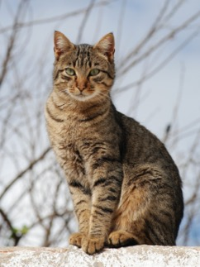
Evaluating Predictor (“Forward Pass”)
h(x)=“Cat”
features x
By Alvesgaspar - Own work, CC BY-SA 3.0, https://commons.wikimedia.org/w/index.php?curid=12127693

Slide 44
Deep Learning = Tune Weights
w1
w2
“Cat”
correct prediction!
-> keep current weights

Slide 45
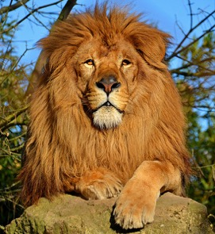
Backward Pass (”Backpropagation”)
w1
w2
h(x)=“Dog”
wrong prediction!
-> change/adjust weights
https://commons.wikimedia.org/wiki/File:Lion_d%27Afrique.jpg

Slide 46
learning is driven by making errors !

Slide 47
Loss Function
maps a pair of predictor map h (e.g. ANN) and data point (x,y) with features x and label y to some number
(h,(x,y)) -> “Loss” (denoted L(h,(x,y)))
loss function is design choice!

Slide 48
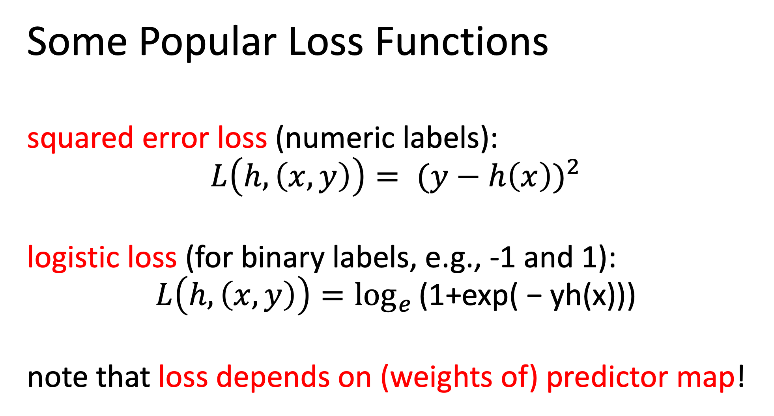
Some Popular Loss Functions
squared error loss (numeric labels):
$${L\left(h,\left(x,y\right)\right)= (y−h\left(x\right))}^{2}$$
logistic loss (for binary labels, e.g., -1 and 1):
$$L\left(h,\left(x,y\right)\right)=\log_{e}{\text{(1+}\text{exp}\text{( − }\text{yh}\text{(}\text{x}\text{)))}}$$
note that loss depends on (weights of) predictor map!

Slide 49
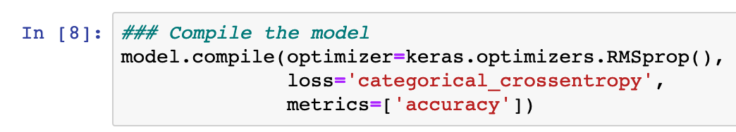
Chose Your Favorite Loss Function!
loss function used for adjusting weights
loss function used for final performance evaluation

Slide 50
Putting Together
the Pieces!

Slide 51
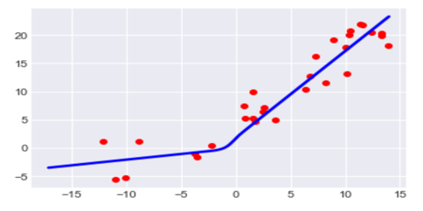
Three Views on Machine Learning
“Data View”
“Model View”
label
w1
w1
feature
“Loss View”
MSE
w1

Slide 52
learn predictor y’=h(x) by tuning
weights w to minimize loss
historic data
linear predictor y’ = w2*x+w1
max temp y
min temp x

Slide 53
Machine Learning = Optimization
average loss on labeled (training) data incurred by predictor h(x)
weights/parameters of predictor map h

Slide 54
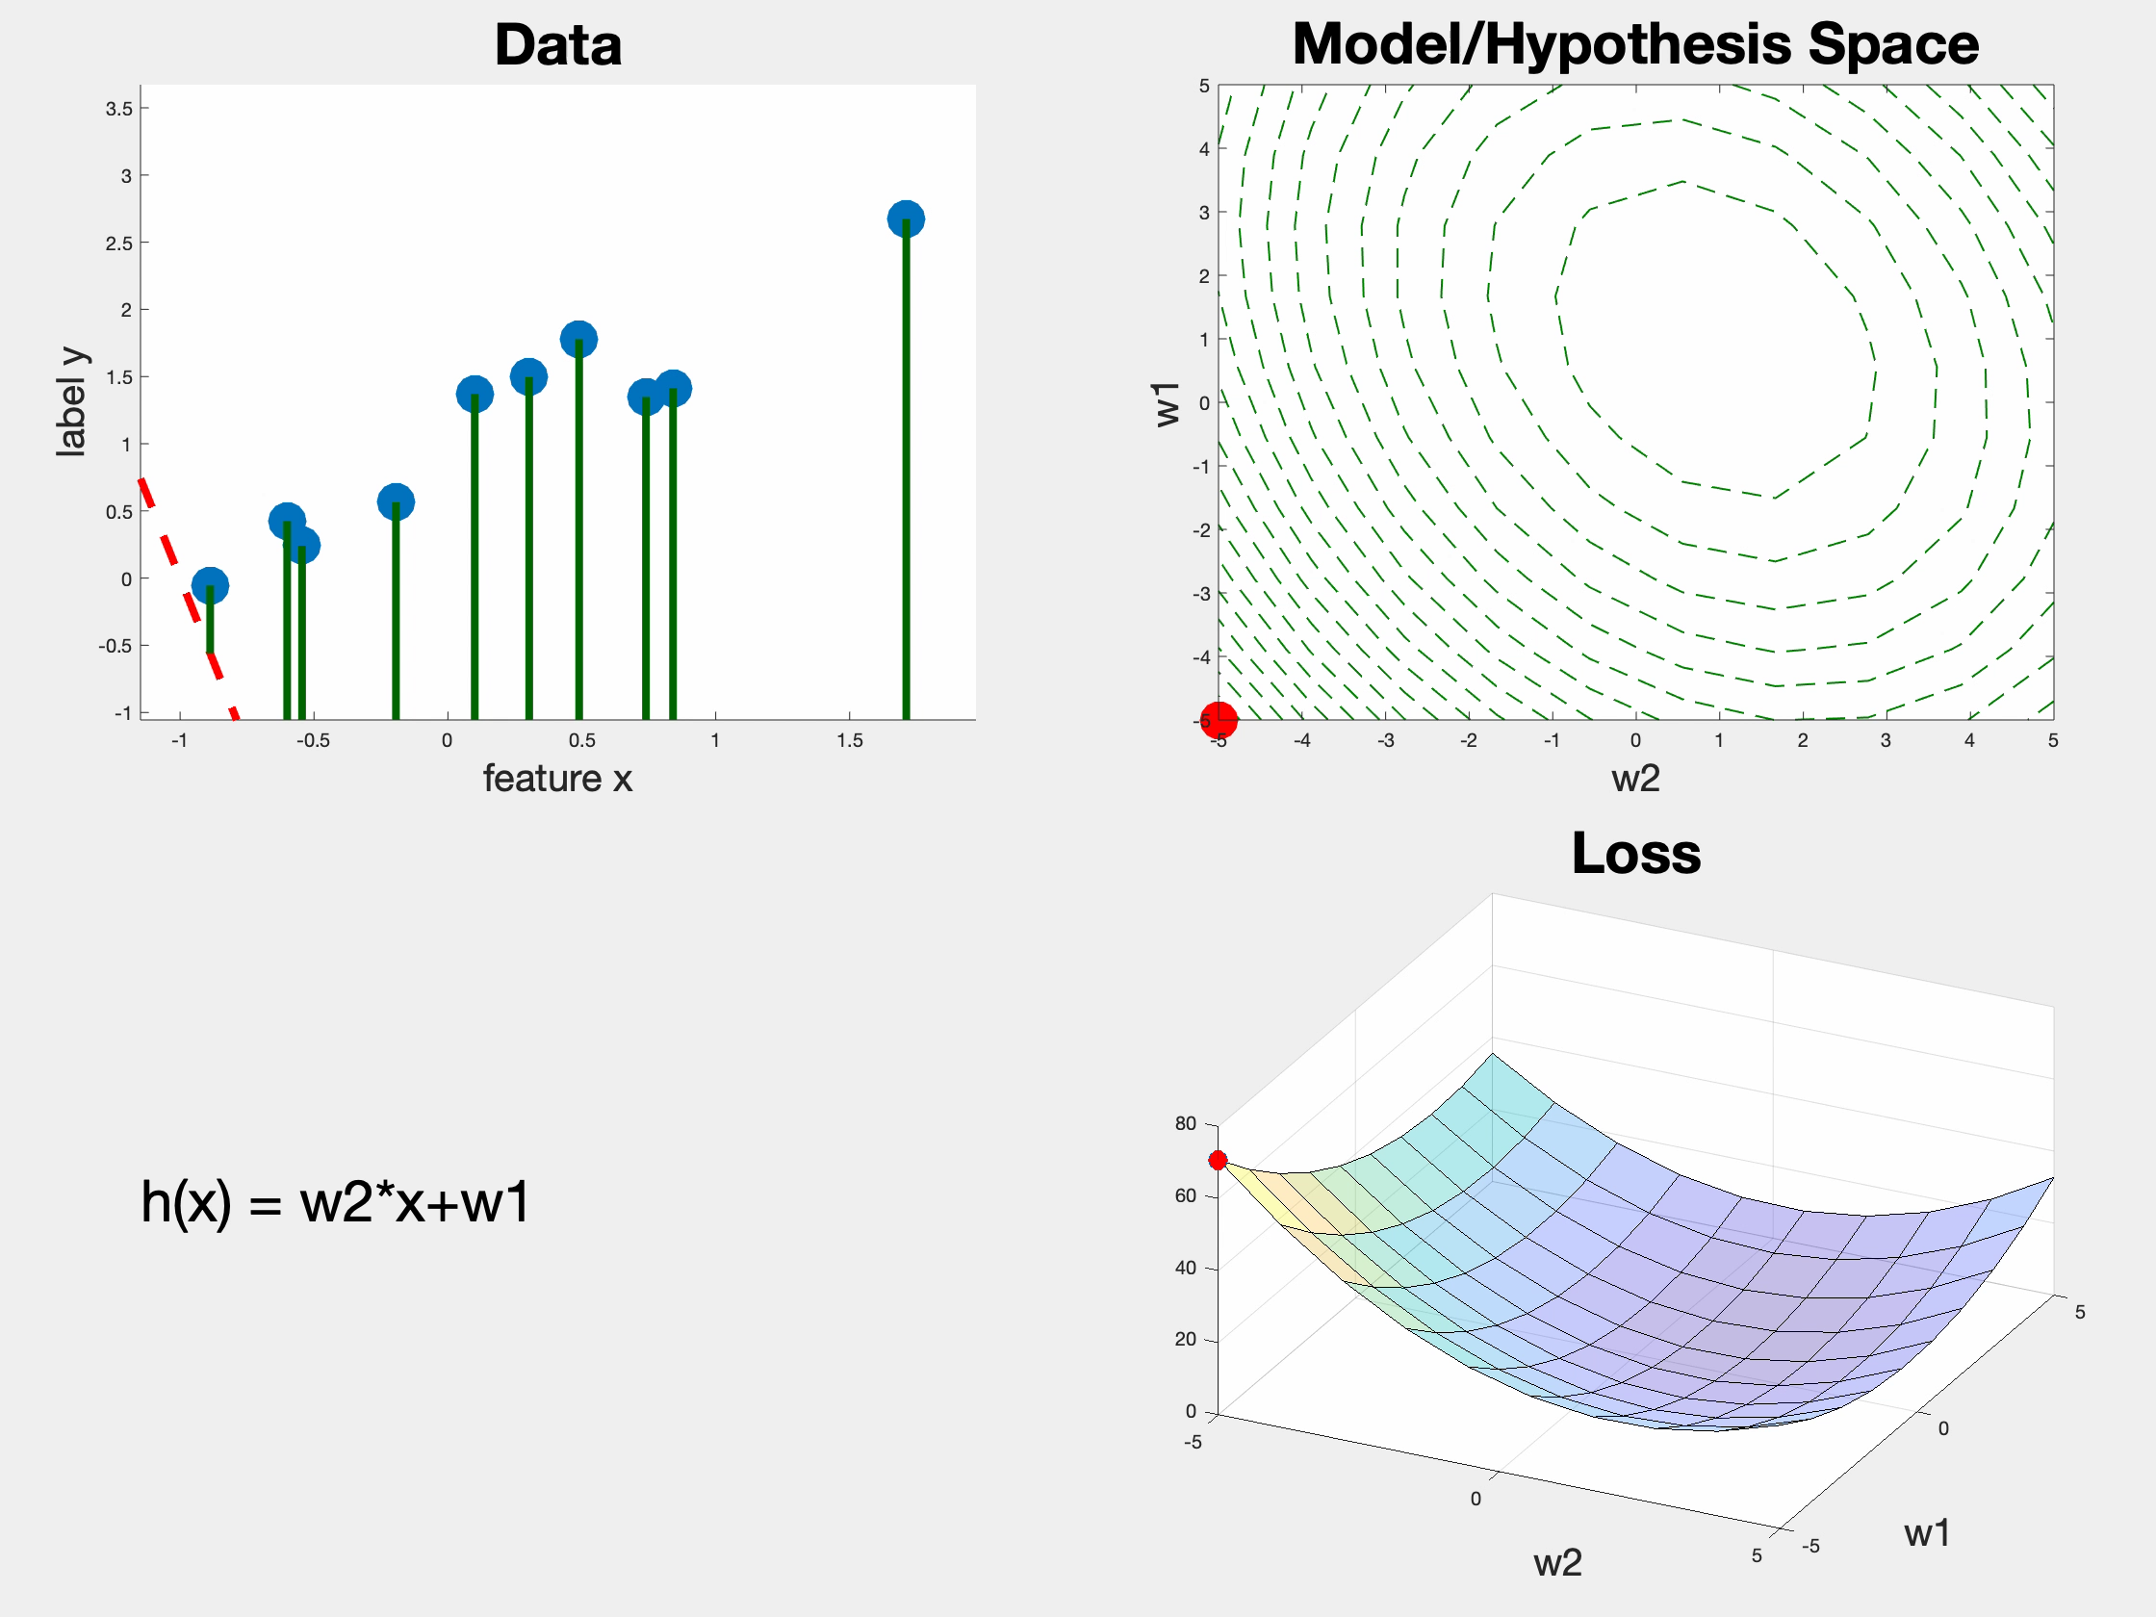

Slide 55

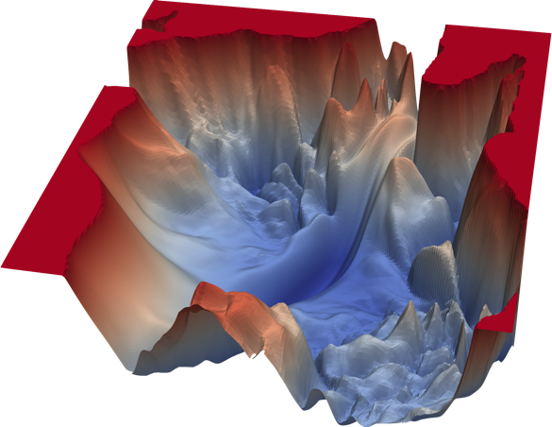

Loss Landscape for Deep Learning
non-convex
non-smooth
high-dimensional
in theory we can evaluate
loss function everywhere !
https://www.cs.umd.edu/~tomg/projects/landscapes/

Slide 56
So far so Good!
assume we have found the best hypothesis based on training set
are we done?

Slide 57
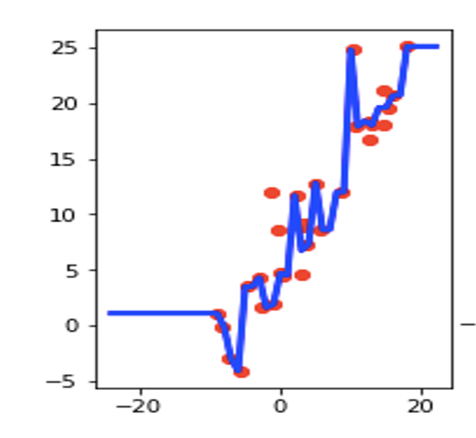
Key Challenge in Machine Learning - Overfitting
small training error but
poor predictor map!
max daytime temp y
min daytime temp x

Slide 58
Detecting Overfitting by Validation
label value
training data points
validation data points
feature value

Slide 59
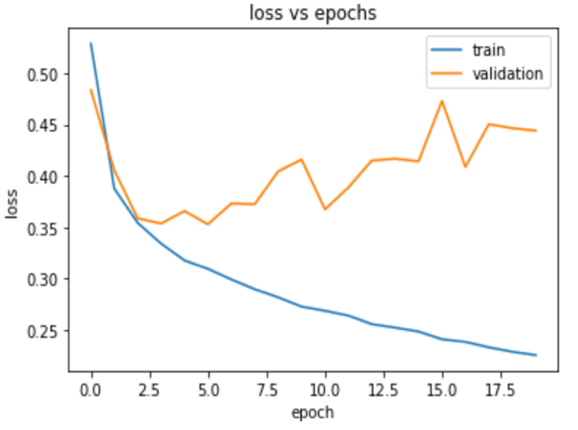
Look at the Validation Set !!!

Slide 60
Training, Validation and Test Set
training set: used to adjust weights
validation set: used to adjust hyperparameters (number of layers..)
test set: final performance evaluation

Slide 61
Test Set
used for final performance evaluation
results on test set MUST NOT BE used for model adjustment!

Slide 62
Diagnosing ML Methods
validation
error
training
error
“human”
performance

Slide 63
Case 1: Overfitting
validation
error
“human”
performance
training
error
possible remedies:
reduce hypothesis space or use more training data

Slide 64
Reducing Hypothesis Space
use fewer neurons in hidden layers
use fewer features (manually choose relevant features)
use fewer layers
use fewer iterations of gradient descent (search only
a smaller subset of the nominal space)
“early stopping”

Slide 65

Early Stopping $≈$ Hypothesis Space Reduction
max. 15 gradient steps
max. 10 gradient steps
max. 5 gradient steps
w0

Slide 66
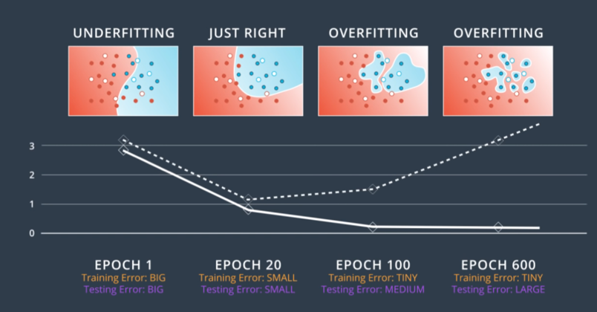
Reducing Effective Hypothesis Space

Slide 67
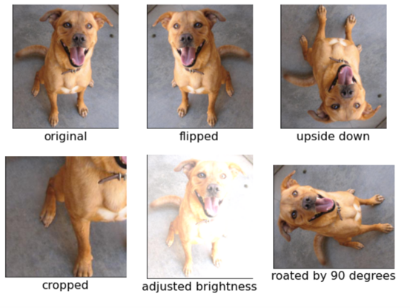
Data Augmentation
enlarge training data artificially
rotated/flipped/mirrored/blurred/noisy dog image is still dog image

Slide 68
Case 2: Underfitting
validation
error
training
error
“human”
performance
possible remedy:
enlarge hypothesis space

Slide 69
Enlarging Hypothesis Space
use deeper nets
use more features
use more iterations of gradient descent

Slide 70
Wrap Up
ML combines data, model and loss
ML methods implement scientific cycle
form model/hypothesis
make prediction based on model
compare prediction with observed data
improve/adjust model
make prediction based on model
compare prediction with observed data
….

Slide 71
Further Reading
F. Chollet, “Deep Learning with Python”
https://aalto.finna.fi/Record/alli.833878
A. Jung, “Machine Learning: Basic Principles” https://arxiv.org/abs/1805.05052
I. Goodfellow, Y. Bengio and A. Courville, “Deep Learning”
https://www.deeplearningbook.org/

Slide 72
That’s All !

